Slide 1
Analysis of Airbnb Data Using Power BI
Deeper understanding of Airbnb's operations and draw meaningful insights from the data using Power BI
Rohan Jain
ABDS – 8B

Slide 2
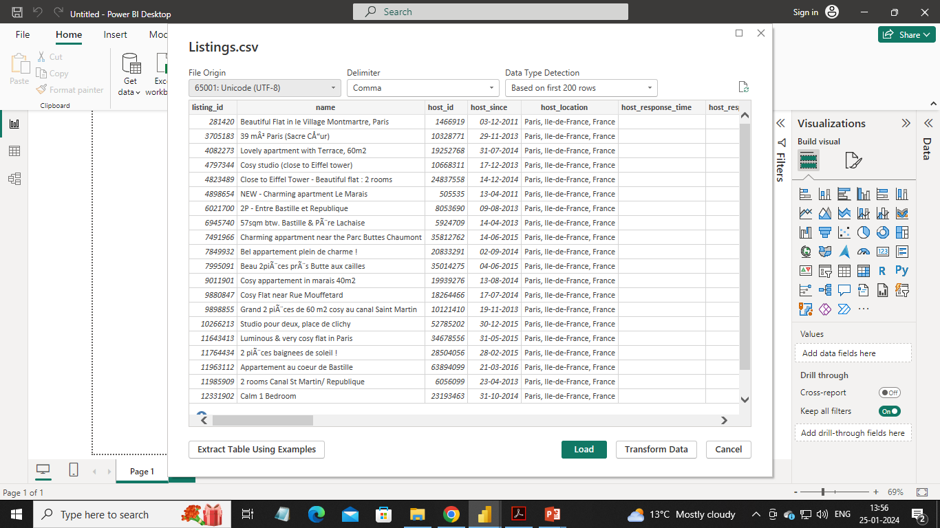
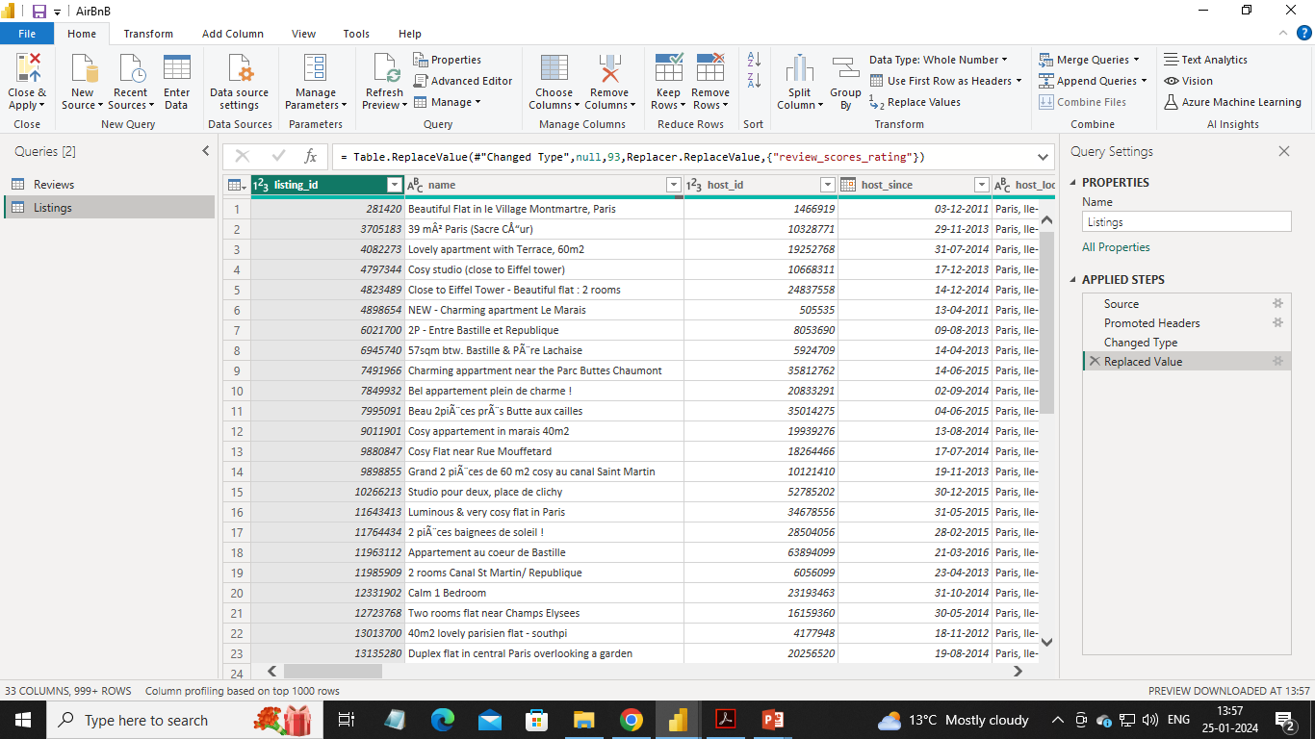
Importing data for the project
Used get data option and imported review and listing files, In Power BI.
Checked and updated data types of columns for the CSV files using power query.

Slide 3
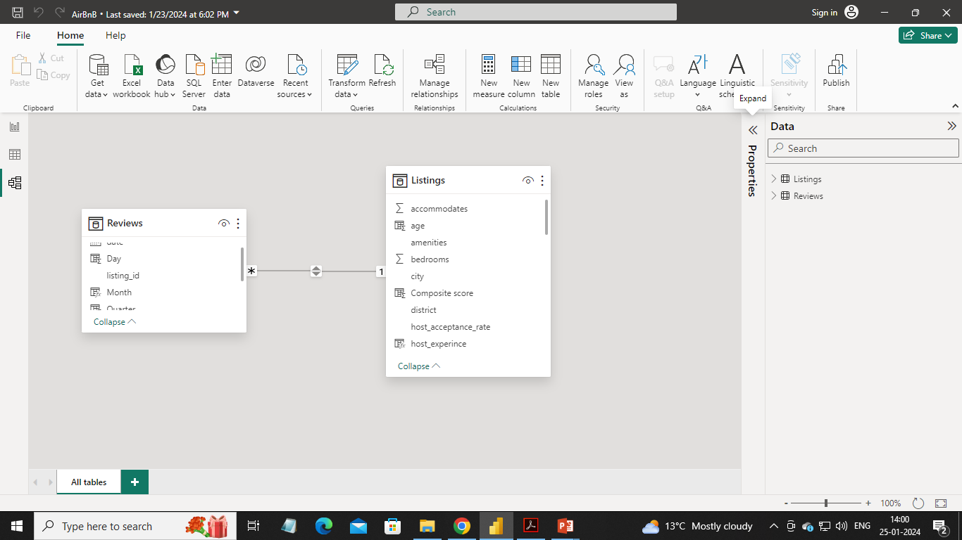
Data Model
Created a data model, using both csv files for AirBnb Analysis.
Used listing_id as connecting field.

Slide 4
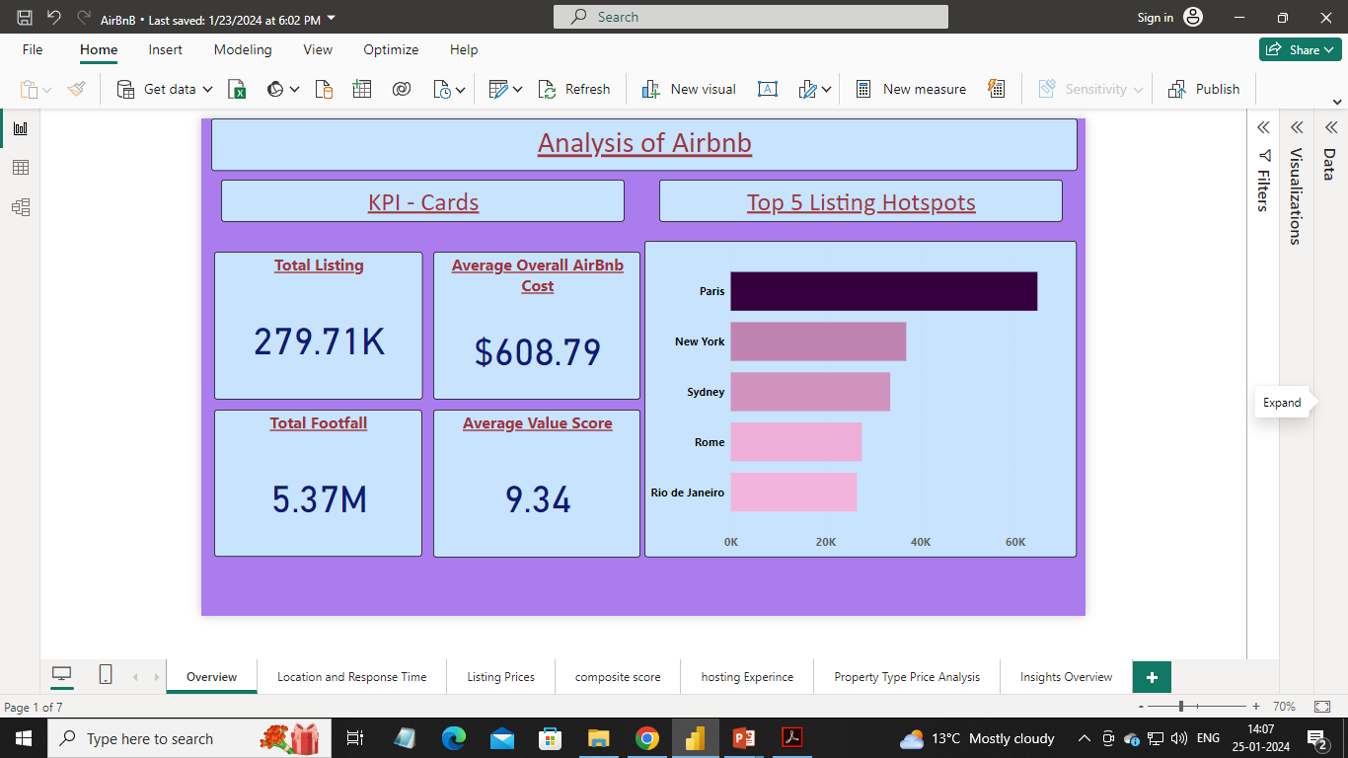
Created Overview Report:

Slide 5
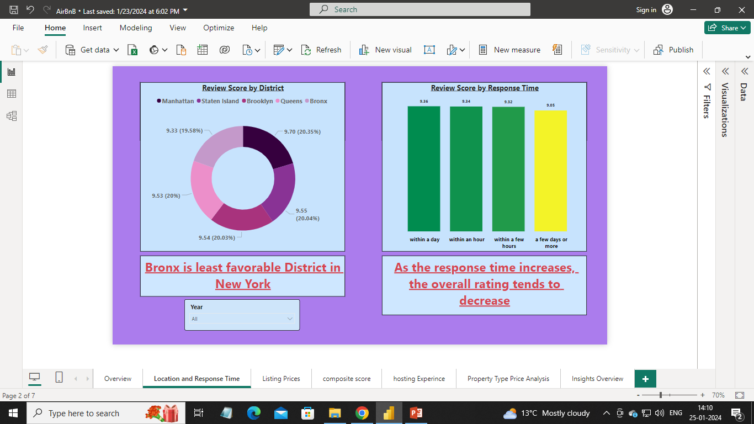
Analyzed District Location Scores and Host Response Time with year slicer option:

Slide 6
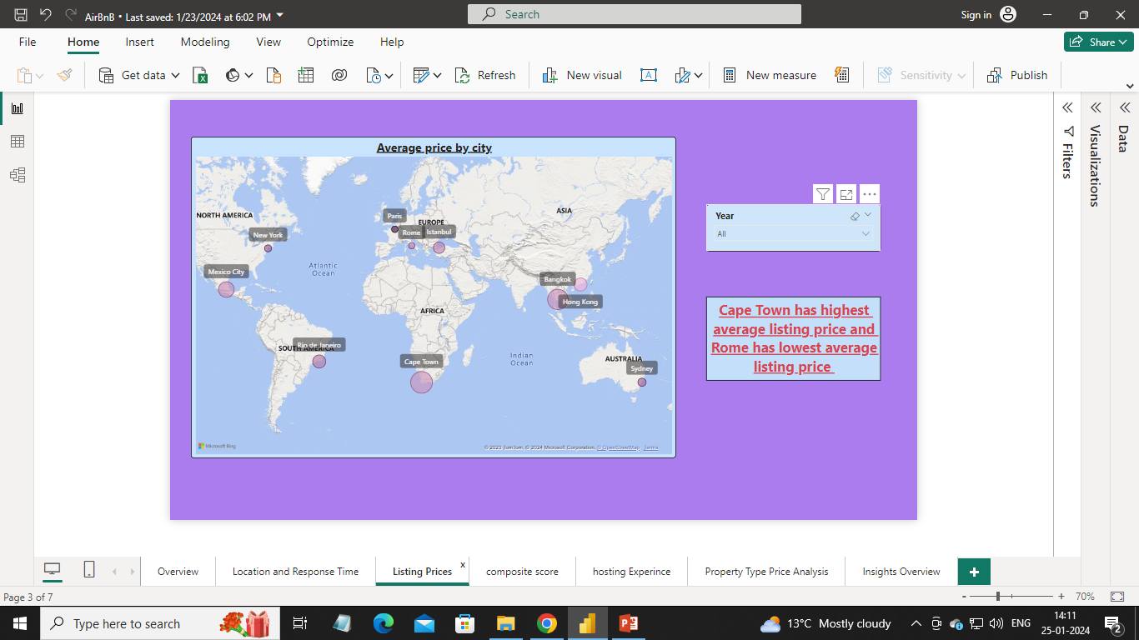
Visualized Airbnb listing prices with year slicer option:

Slide 7
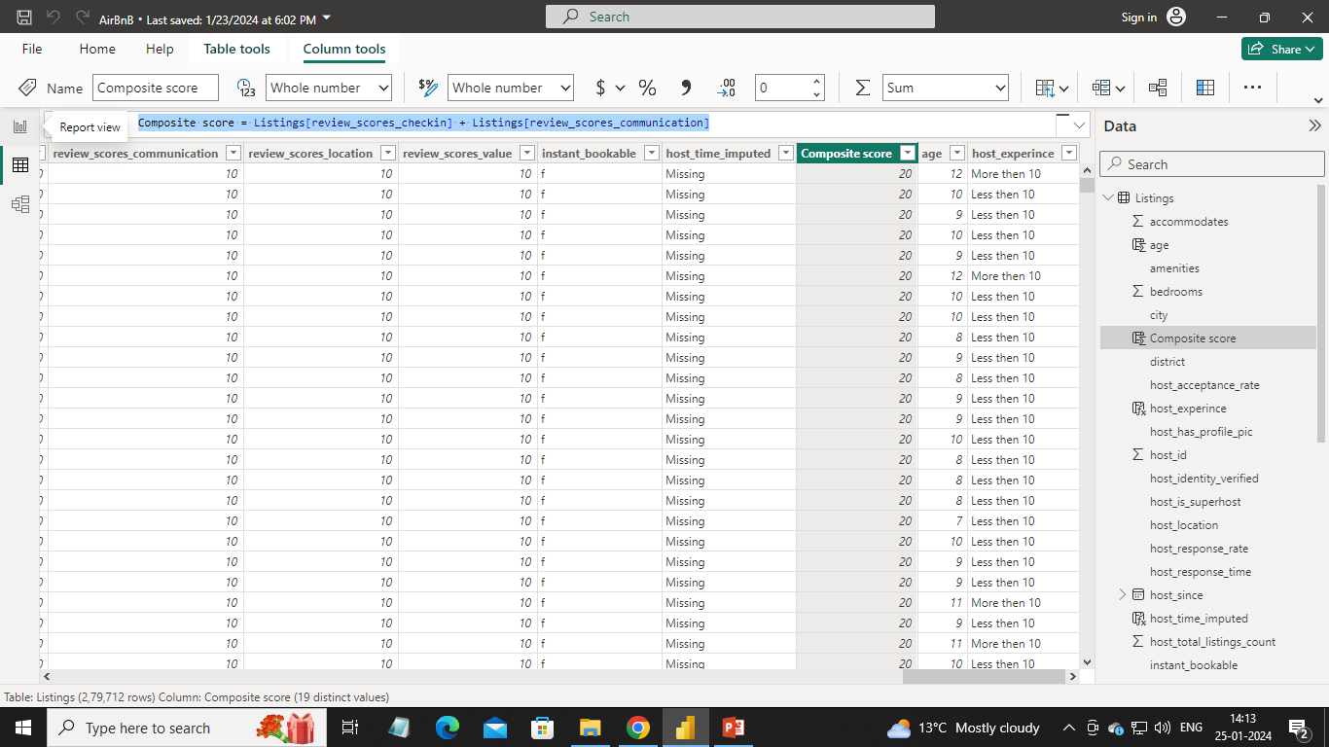
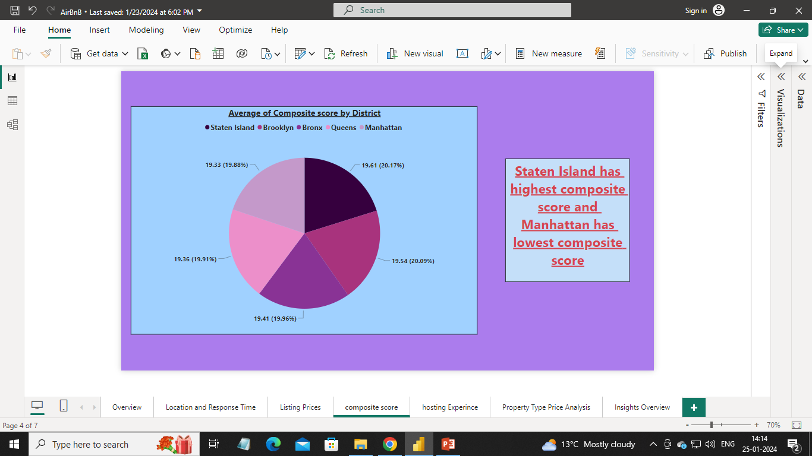
Analyzed composite scores:
Created a composite score column:
Visualized districts using composite score

Slide 8
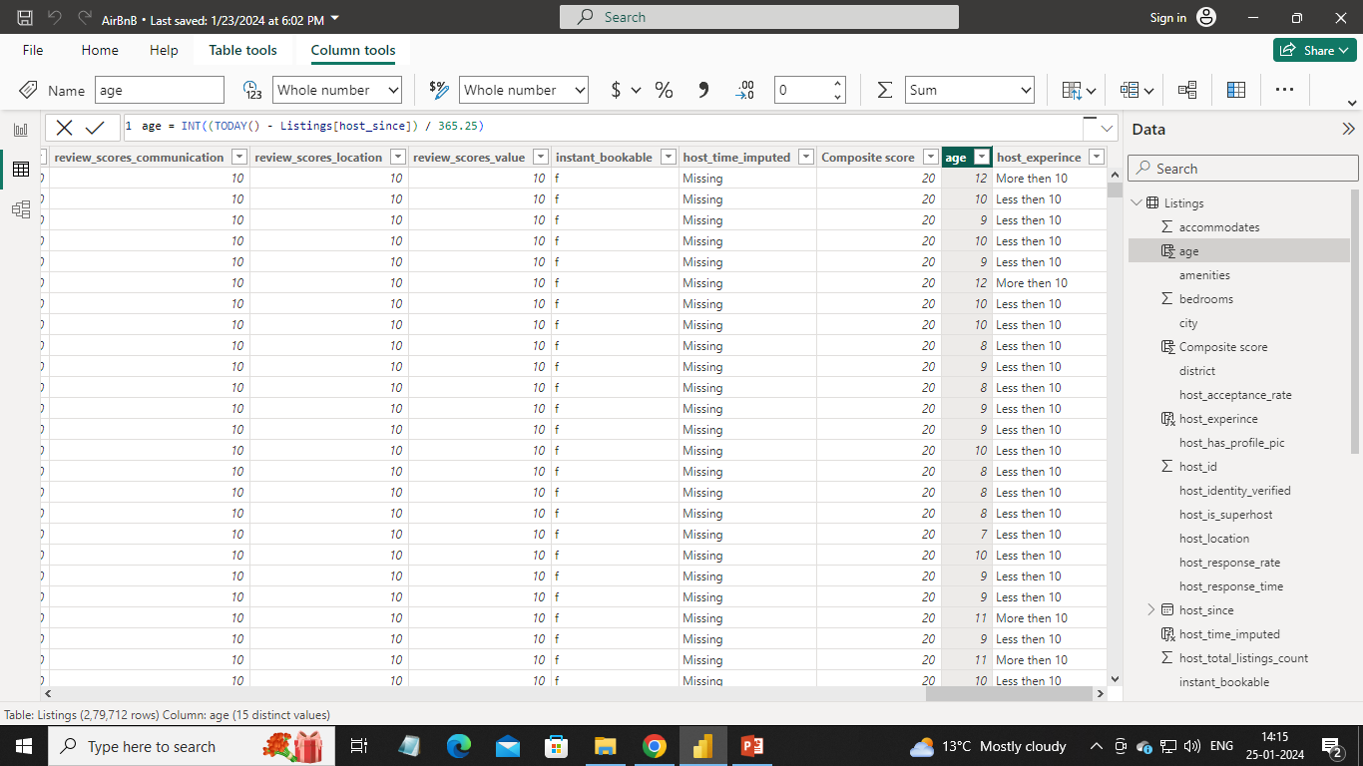
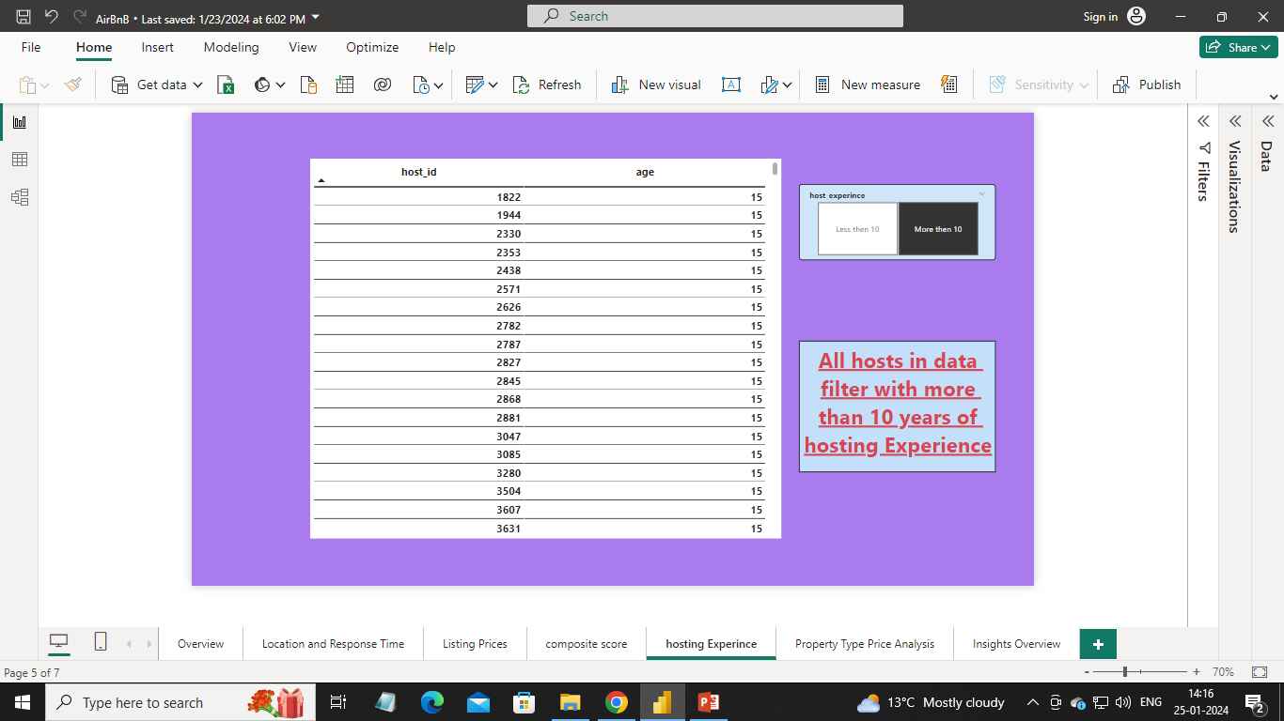
Analyzed listing age and host tenure:
Created a age and host_experience column:
Visualized listing age and host tenure:

Slide 9
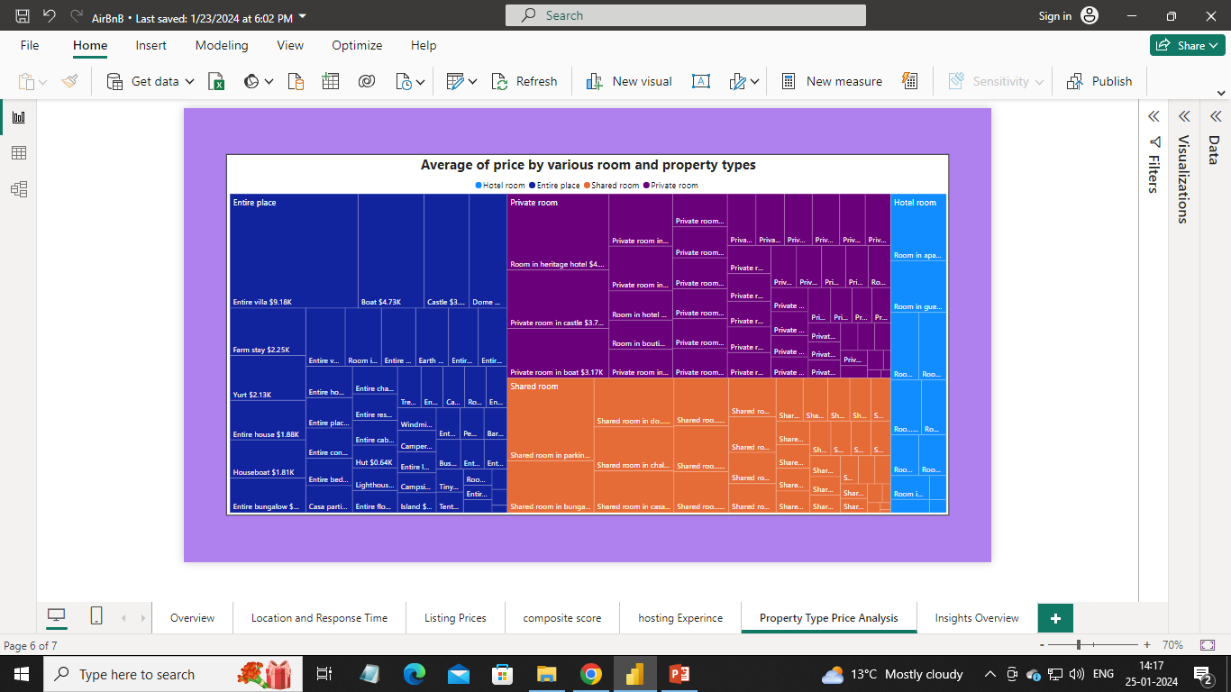
Visualized Airbnb Property Type Price Analysis:

Slide 10
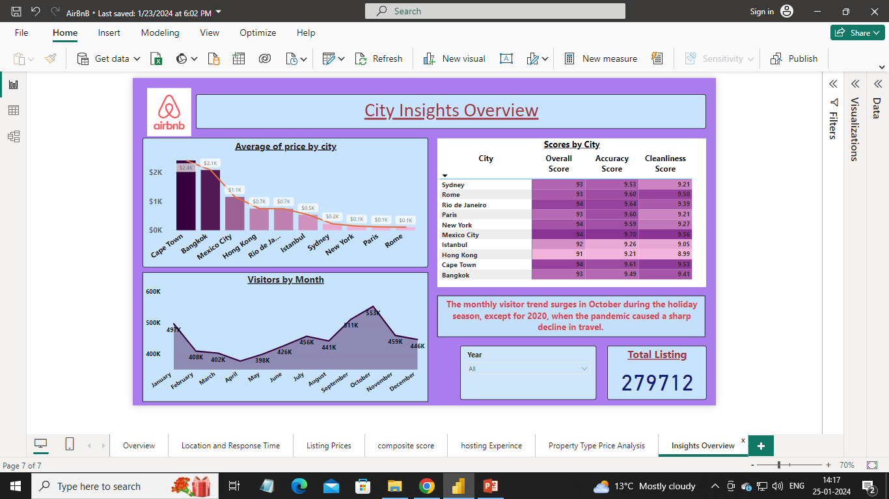
Creadted a Comprehensive City Insights Report:

Slide 11
Please ask any Questions?

Slide 12
Thank You!!

